Slide 1
ESC101: Fundamentals of Computing
Arrays and functions
Nisheeth

Slide 2
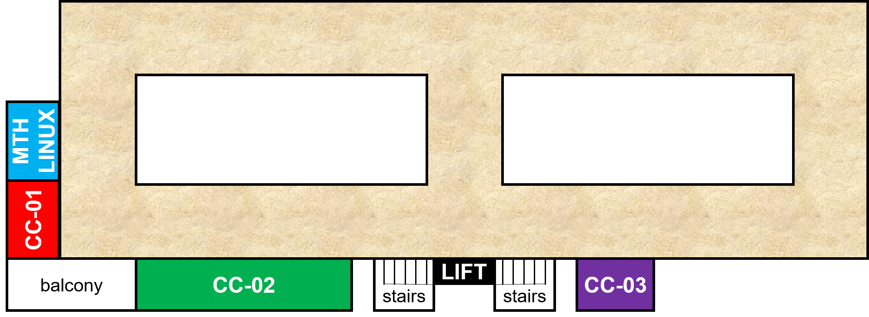
Mid-sem Lab Exam: February 15 (Saturday)
Morning exam
10:00 AM - 12:30 PM – starts 10:00 AM sharp
CC-01: A9, {A14 even roll numbers}
CC-02: A7, A10, A11
CC-03: A12
MATH-LINUX: A8, {A14 odd roll numbers}
Afternoon exam
12:45 PM – 3:15 PM – starts 12:45 PM sharp
CC-01: A1, {A2 even roll numbers}
CC-02: A4, A5, A6
CC-03: A3
MATH-LINUX: A13, {A2 odd roll numbers}

Slide 3
Mid-sem Lab Exam: February 15 (Saturday)
Go see your room during this week’s lab
Be there 15 minutes before your exam time
No entry for candidates arriving later than 09:45 for morning exam and 12:30 pm for the afternoon exam
Cannot switch to another session (morning to afternoon or vice-versa)
Syllabus – till functions (no arrays)
Open handwritten notes – However, NO printouts, photocopies, slides, websites, mobile phone or tablet
POSSESSING ANY OF THESE WILL BE CONSIDERED CHEATING
Prutor CodeBook will be unavailable during lab exam
Exam will be like labs - marks for passing test cases
Marks for writing clean indented code, proper variable names, a few comments – illegible code = poor marks

Slide 4
Recap: Passing by value
// swapping a and b
void swap(int a, int b){
int temp;
temp = a;
a = b;
b = temp;
printf("a=%d b=%d\n", a, b);
}
int main(){
int a=10, b=15;
printf("a=%d b=%d\n", a, b);
swap(a, b);
printf("a=%d b=%d\n", a, b);
return 0;
}
What is the output of the program?
(fill the blanks)
OUTPUT
a=___ b=___
a=___ b=___
a=___ b=___
10
15
10
15
15
10

Slide 5
Recap: Parameter passing
Basic steps:
Create new variables (boxes) for each of the formal parameters allocated on a fresh stack area created for this function call.
Copy values from actual parameters to the newly created formal parameters.
Create new variables (boxes) for each local variable in the called procedure. Initialize them as given.
Today, we will look at parameter passing more carefully. Pay attention!

Slide 6
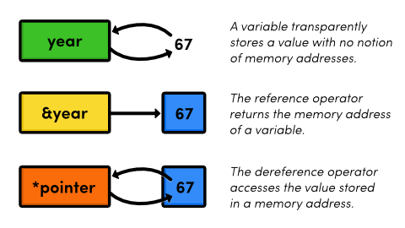
Values and addresses
Pointers are special variables that store memory addresses
We will cover pointers in much greater depth soon

Slide 7
Argument passing by value and reference
#include <stdio.h>
long sum(long a, long b){
printf("%ld\t%ld\n", &a, &b); printf("%ld\t%ld\n", a, b);
return a+b;
}
int main(){
long a=2,b=3;
printf("%ld\t%ld\n", a, b);
printf("%ld\t%ld\n", &a, &b); printf("%ld\n",sum(a,b)); printf("%ld\n",sum(&a,&b));
return 0;
}
Output:
2 3
140732008792672 140732008792664
140732008792616 140732008792608
2 3
5
140732008792616 140732008792608
140732008792672 140732008792664
281464017585336

Slide 8
Passing by reference
Telling compiler you will be passing a memory address, not a value
Pass address using reference operator (&) during function call
So far, we have thought of variables x as values
More accurate to think of x as ‘the value stored at x’
&x is the memory address of x

Slide 9
Passing arrays by value
Can pass array elements to functions
Treated like normal variables
This is passing an array by value
We are passing the values stored in the array to a function
What else could we be passing?
#include <stdio.h>
void shift( char ch) {
printf("%c ", ch+4);
}
int main() {
char arr[] = {'a', 'b', 'c'};
for (int x=0; x<3; x++) {
shift (arr[x]);
}
return 0;
}

Slide 10
Passing arrays by reference
Write a function that reads input into an array of characters
until EOF is seen or array is full.
int read_into_array
(char t[], int size);
/* returns number of chars
read */
int read_into_array
(char t[], int size) {
int ch;
int count = 0;
ch = getchar();
while (count < size
&& ch != EOF) {
t[count] = ch;
count = count + 1;
ch = getchar();
}
return count;
}
read_into_array:
array t (arg.)
size of the array (arg.)
reads the input in array
int main() {
char s[100];
read_into_array(s,100);
/* process */
}
But what’s the point of this code? Counting inputs?

Slide 11
int main() {
char s[10];
read_into_array(s,10);
…
int read_into_array
(char t[], int size) {
int ch;
int count = 0;
/* … */
}
s
s[0] s[1] s[2]
s[9]
Array variables
store address!!
s is an array. It is a
variable and it has a box.
The stack
of main
just prior
to call
The value of this box is the address of the first element of the array.

Slide 12
int main() {
char s[10];
read_into_array(s,10);
…
Create new variables (boxes) for
each of the formal parameters
allocated on a fresh stack created
for this function call.
int read_into_array
(char t[], int size) {
int ch;
int count = 0;
/* … */
}
Copy values from actual parameters to the newly created formal parameters.
s
s[0] s[1] s[2]
s[9]
t
size
10

Slide 13
Parameter Passing: Arrays
s
s[0] s[1] s[2]
s[9]
t copies the value in s, so t points to the same address as s.
t
size
10
s and t are the same array now,
with two different names!
s[0] and t[0] refer to the same variable.

Slide 14
Implications of copying content of array variable during parameter passing
s[0] s[1] s[2]
s[9]
s
An array (s) is identified with a box whose value is the address of the first element of the array.
t
10
size
In the computer, an address is simply the value of a memory location.
The value in the box for s would be the memory location of s[0].
The value of s is copied into t.
Value in the box of t
=
Value in the box of s.
They both now contain the address of the first element of the array.

Slide 15
int read_into_array
(char t[], int size) {
int ch;
int count = 0;
ch = getchar();
while (count < size
&& ch != EOF) {
t[count] = ch;
count = count + 1;
ch = getchar();
} return count;
}
s
read_into_array
t
size
10
s[0]
‘W’
s[1]
‘I’
s[2]
‘N’
3
1
2
‘W’
‘I’
EOF
0
‘N’
s[3]
ch
count
int main() {
char s[10];
read_into_array(s,10);
…
s[9]
return
value
return
addr
main
3
main.3
Input
WIN<eof>

Slide 16
s
t
count
3
s[0]
‘W’
s[1]
‘I’
ch
State of memory just prior to returning from the call read_into_array()
s[2]
‘N’
EOF
s[3]
size
10
value
return
3
s[9]
main
addr
return
main.3

Slide 17

s
State of memory just after returning from the call read_into_array().
All local variables allocated for read_into_array() on stack may be assumed to be erased/de-allocated.
s[0]
‘W’
s[1]
‘I’
Only the stack for main() remains, that is, all local variables for main() remain.
s[2]
‘N’
s[3]
Behold !!
The array s[] of main() has changed!
s[9]
THIS DID NOT HAPPEN BEFORE!
WHAT DID WE DO DIFFERENTLY?
main
Ans: we passed the array s[] by reference

Slide 18
Next Class
After the mid-sem
We will talk about arrays and functions some more

